Slide 1
Trade Implications of the Trans-Pacific Partnership for ASEAN and Other Asian Countries
Alan V. Deardorff
University of Michigan
For presentation at
2nd 2013 Asian Development Review Conference
August 1-2, 2013, Manila

Slide 2
The Trans-Pacific Partnership (TPP)
Currently being negotiated among
12 countries
P4 from 2006: New Zealand, Singapore, Brunei Darussalam, Chile
Added as TPP from 2008: Australia, Peru, United States, Vietnam
Added
2009: Malaysia
2011: Canada, Mexico
2013: Japan

Slide 3
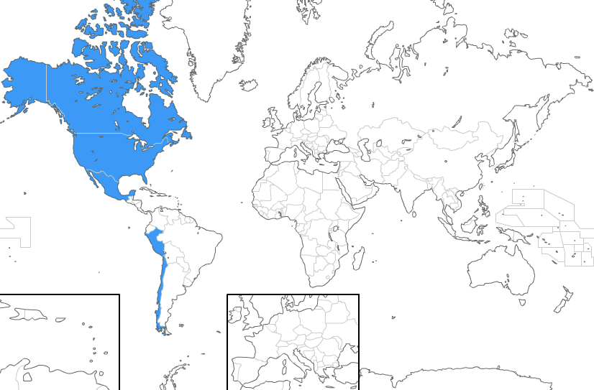
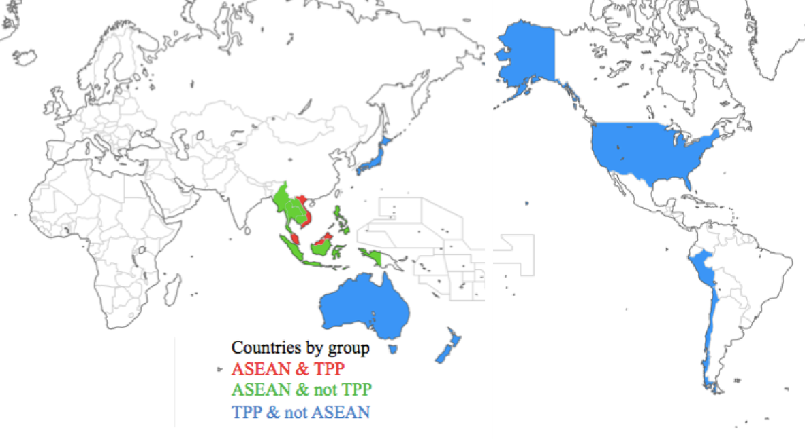
Figure 1
Countries of the TPP and AFTA

Slide 4
The ASEAN Free Trade Area (AFTA)
Since 1992 (as reported to WTO)
10 Countries
ASEAN-6: Brunei Darussalam, Indonesia, Malaysia, the Philippines, Singapore and Thailand
Newer members: Cambodia, Laos, Myanmar and Viet Nam

Slide 5
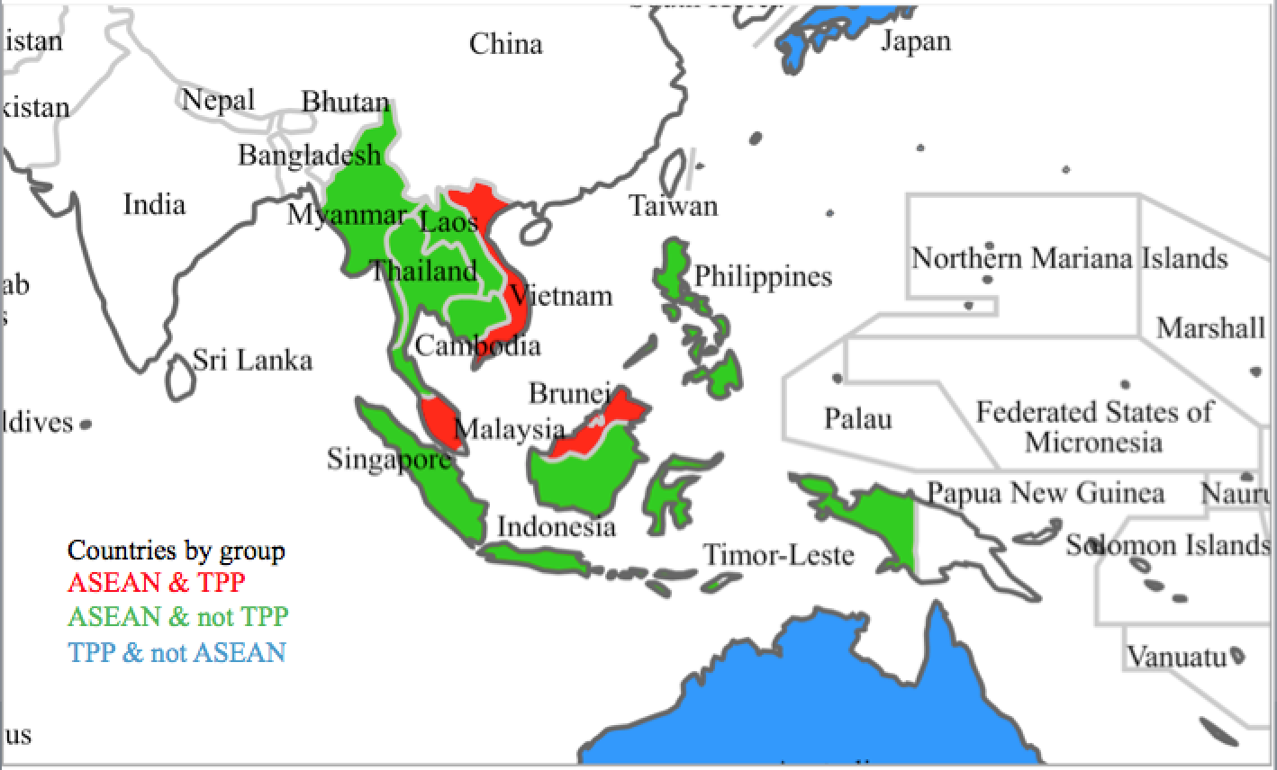
Figure 2
ASEAN

Slide 6
Other Asia
I will also look at 10 other Asian economies not part of TPP or AFTA:
Bangladesh, China, Hong Kong, India, Macao, Nepal, Pakistan, South Korea, Sri Lanka, Taiwan

Slide 7
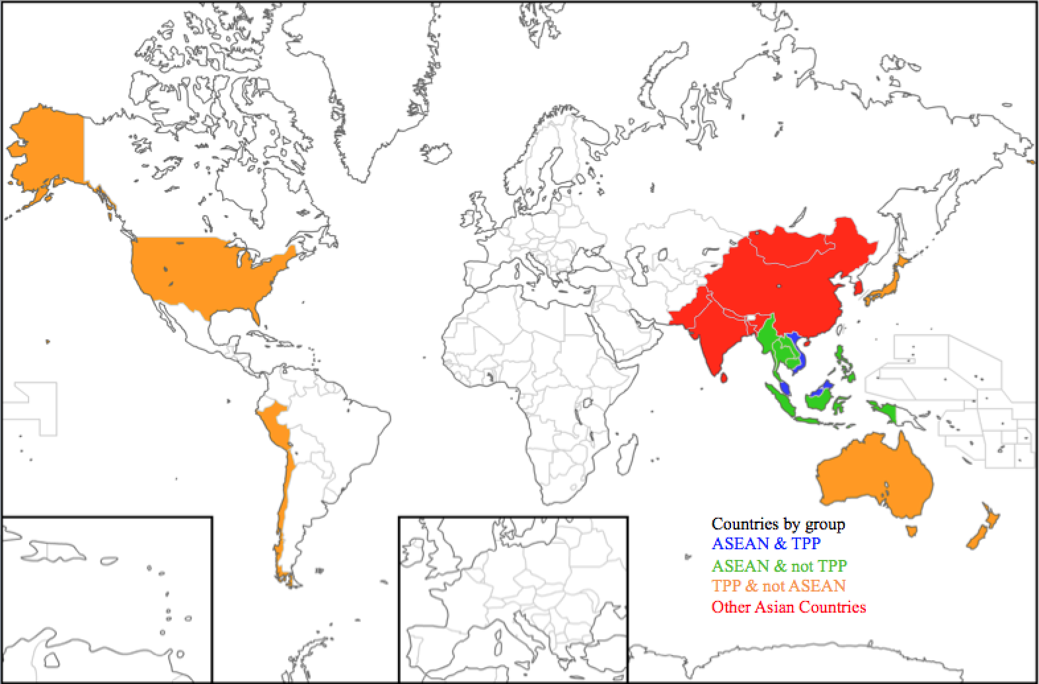

Slide 9
My Issue: How will TPP affect the trade of AFTA and other Asia?
Why this is of interest:
TPP is large, both geographically and economically
TPP overlaps with AFTA and other FTAs
TPP will extend well beyond trade and trade barriers (tariffs & NTBs) to include many other issues
Some trade related
Some domestic

Slide 10
Outline
Description of TPP
Overlaps of TPP with AFTA and other Asian FTAs
Major trading partners of TPP and Asian economies
Effects of TPP by economy

Slide 11
TPP
Free Trade Area (FTA)
Zero tariffs on (almost) all goods trade among member countries
No change in tariffs on imports from outside; thus mostly unequal tariffs
Rules of Origin (ROOs)

Slide 12
TPP
Other Trade Issues
Trade in Goods
Nontariff barriers
Trade remedies
Rules of origin
Trade in Services

Slide 13
TPP
Non-Trade Issues
Intellectual property protection
Competition policy
Temporary movement of business persons
Labor rights
Environmental laws and regulations

Slide 14
TPP
Non-Trade Issues
Regulatory coherence
Digital technologies
Financial services
Investment

Slide 15
TPP
Issues often mentioned, but not explicitly part of TPP
State-owned enterprises
Currency manipulation

Slide 16
Overlap of TPP with AFTA and other FTAs
TPP overlap
4 countries of AFTA: Brunei, Malaysia, Singapore, Vietnam
Many FTAs among TPP countries: e.g., Australia-New Zealand, NAFTA, etc.
Bilateral FTAs with ASEAN: Australia, Japan, New Zealand
Bilateral FTAs of TPP countries with Other Asian economies: e.g., Chile-China, Japan-India, New Zealand-Hong Kong, Peru-S. Korea

Slide 17
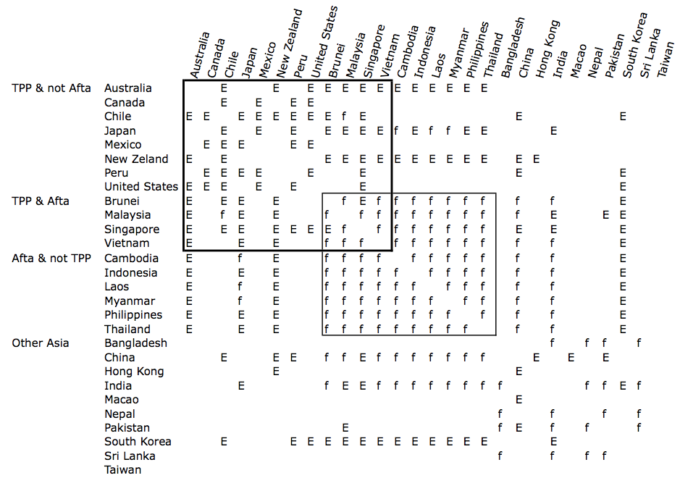
Figure 4: Existing FTAs & EIAs
E = Economic Integration Agreement
F = FTA

Slide 18
Overlap of TPP with AFTA and other FTAs
Messages:
TPP countries are already heavily linked by existing FTAs:
Most are Economic Integration Agreements (EIAs).
Of 66 possible pairs of countries in the 12-country TPP,
40 already have FTAs,
all but 6 of which are EIAs.

Slide 19
Overlap of TPP with AFTA and other FTAs
Messages:
For the 4 countries in both AFTA and TPP
Only one pair (Brunei-Singapore) has an EIA.
Others have only FTAs, thus subject to greater economic integration as a result of the TPP.
They are in 17 of possible 32 FTAs with other TPP countries, all-but-one are EIAs
Only Singapore has EIA with US, which is probably most demanding as TPP

Slide 20
Overlap of TPP with AFTA and other FTAs
Messages:
The six countries that are part of AFTA but not part of the TPP already have FTAs with three of the non-AFTA TPP countries – Australia, Japan, and New Zealand – negotiated between them and ASEAN as a group.

Slide 21
Overlap of TPP with AFTA and other FTAs
Messages:
Among the 10 countries in Other Asia,
3 (China, India, and South Korea) have FTAs with the AFTA countries and
at least one with the non-AFTA TPP countries.

Slide 22
Trade Effects of TPP
Three main effects
Trade creation: Import from partner what was previously produced at home
Trade diversion: Import from partner what was previously imported from 3rd country
Reversal of trade diversion: Import from new partner what had been diverted to partner in prior FTA (“trade un-diversion”? “trade reversion”)
Also one non-effect: TPP will have little effect on trade with countries already subject to FTA

Slide 23
Trade Effects of TPP
Focus mainly on largest trade flows
Top-five partners for exports
Top-five partners for imports

Slide 24
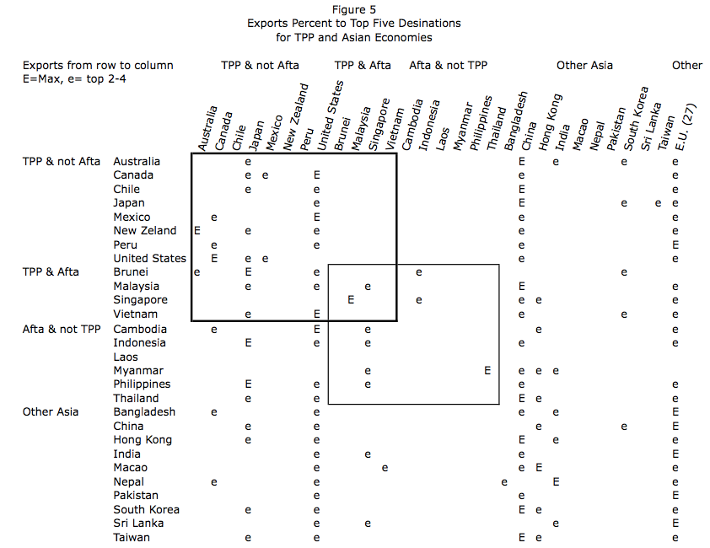

Slide 25
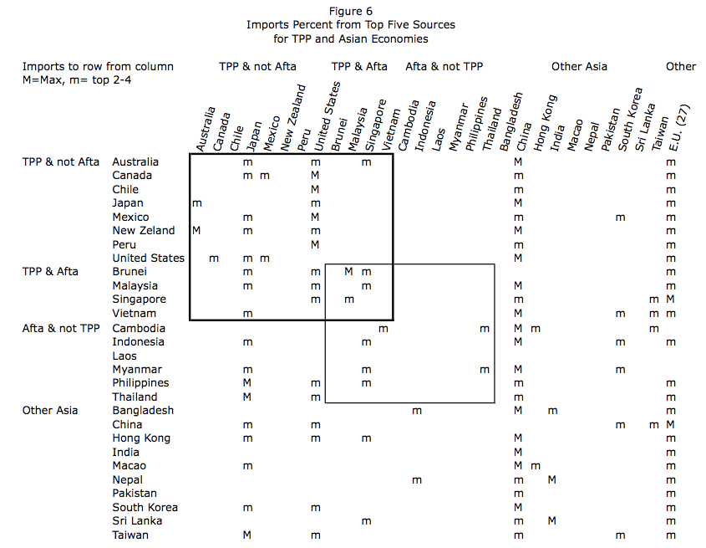

Slide 26
Trade Effects of TPP
In the paper I talk through the effects on individual countries and groups of countries in TPP, AFTA, and Other Asia
Discussion is based on the presence and absence of FTAs in Figure 4 covering the major trade flows indicated in Figures 5 & 6
Here I will just mention a few examples

Slide 27
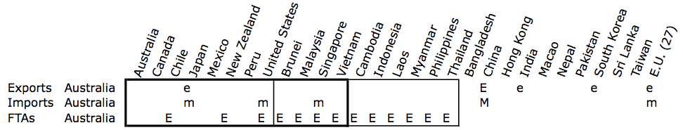
Australia
Largest trade partner is China, for both exports and imports. TPP will divert trade from China
TPP will eliminate tariffs with only one top trading partner: Japan
Already has FTAs with 7 other TPP countries, so little effect except on trade with Japan
Japan and Australia will both benefit from reversing Australia’s trade diversion to US
Australia therefore likely to benefit

Slide 28
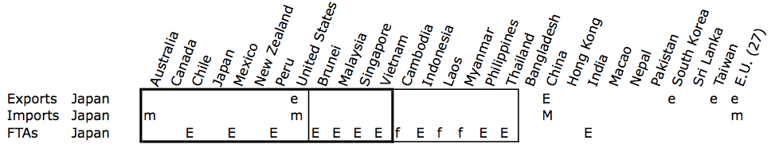
Japan
Largest trade partner is China
Major trade partners in TPP are
US for exports and imports
Australia for imports
TPP will be primarily a Japan-US FTA
Will reverse trade diversion due to NAFTA and other US FTAs
Will cause substantial trade diversion away from China
Net effect on Japan is hard to say

Slide 29
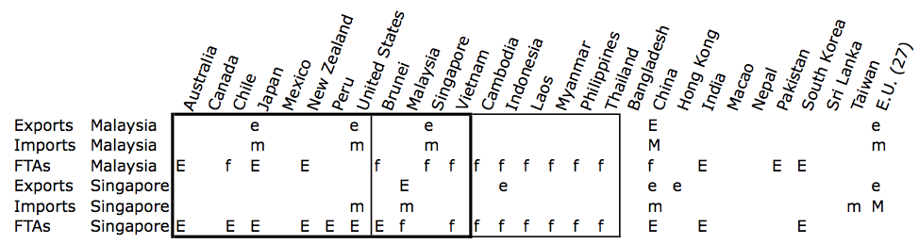
Countries of both TPP & AFTA
Brunei, Malaysia, and Vietnam
All have FTAs already with major trading partners except US
These FTAs have diverted their trade from US
TPP will undo that trade diversion
They’ll benefit
Singapore is like the others, except that
It already has FTA with US
Reversal of trade diversion will occur for trade with Canada and Mexico, but this is small
Singapore will benefit, but only a little

Slide 30
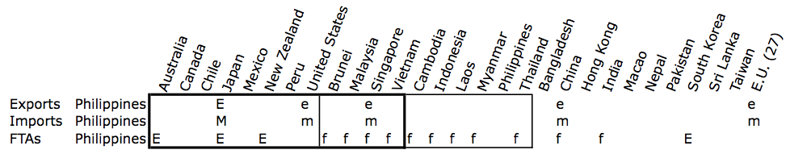
Countries in AFTA but not TPP
Cambodia, Indonesia, Laos, Myanmar, Philippines, and Thailand
All share the ASEAN FTAs with Australia and New Zealand, Japan, China, India, and South Korea
TPP will cause some trade diversion away from (AFTA/not TPP) countries by AFTA/TPP members, but these are not major trade partners, so the effect will be small
More serious will be trade diversion away from these by Japan and US, which are major trade partners
These countries are likely to be harmed by the TPP

Slide 31
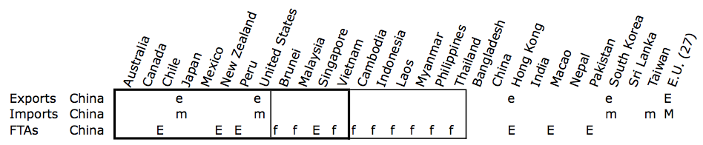
Countries Other Asia (not in AFTA or TPP)
All of these should expect some loss from trade diversion, tempered somewhat by existing FTAs
China
Has FTAs with AFTA plus Chile, New Zealand, & Peru
But has no FTAs with others, including major trading partners US and Japan
Will be a major loser from the TPP

Slide 32
Conclusion
Trade effects of TPP on Asian economies will be
Non-trivial trade diversion, especially for China
Positive in several cases as TPP reverses effects of previous trade diversion

